Slide 1
Functional Verification of a MIPS CPU using UVM
Lukas Mazzetti, George Dagis
Instructor: Yi-Chung Chen
EGC447 Functional Verification of Hardware Systems

Slide 2
What is UVM?
Methodology for functional verification using SystemVerilog classes
Most efficient when verification procedures require randomization and/or functional coverage
Requires a basic understanding of OOP and TLM

Slide 3
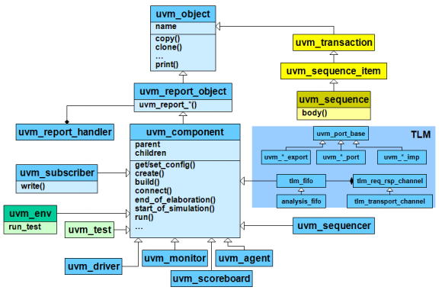
UVM Hierarchy

Slide 4
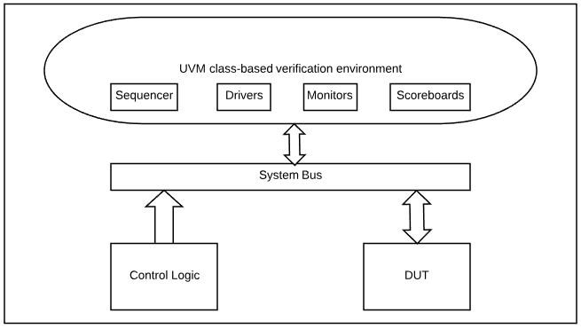

Slide 5
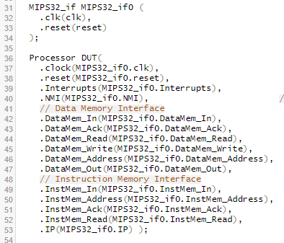

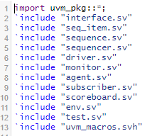



TOP.sv

Slide 6
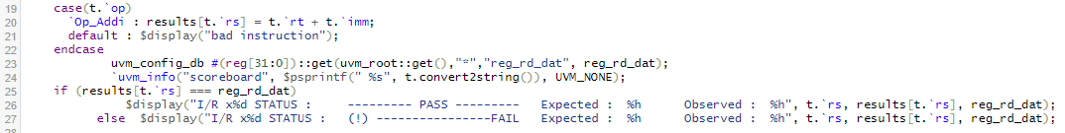
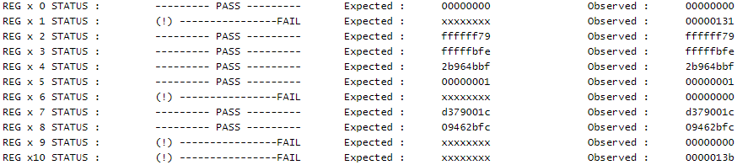
scoreboard.sv

Slide 7
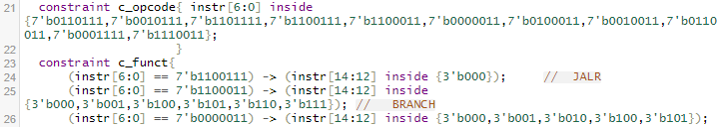

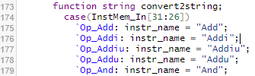

seq_item.sv

Slide 8
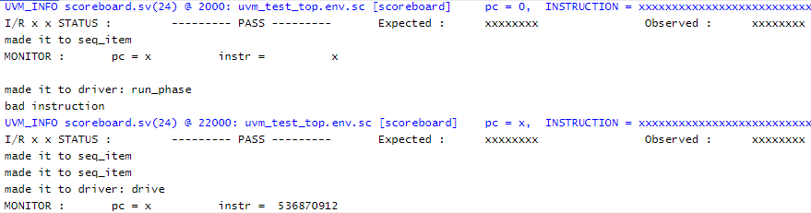
Results
Problem with timing?
Problem with the hand shake process?

Slide 9
References
https://github.com/grantae/mips32r1_core
http://engr.newpaltz.edu/~cheny/EGC4472019S/note447.html
https://www.aldec.com/en/support/resources/multimedia/webinars

